Slide 1

STOR 120: Foundations of Statistics and Data Science
Department of Statistics & Operations Research
Class 29: Review

Slide 2
Probability

Slide 3
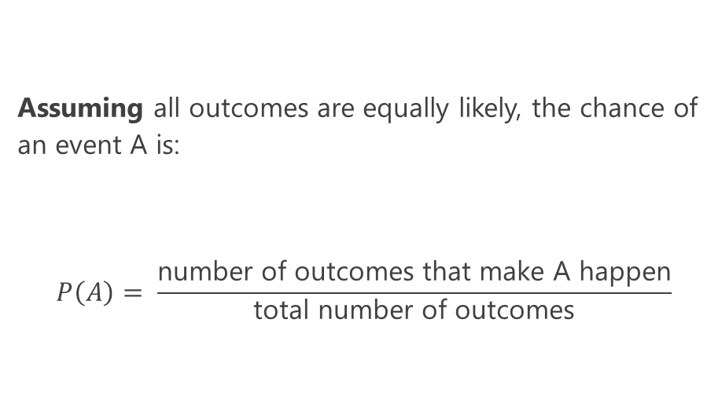
Probability
Assuming all outcomes are equally likely, the chance of an event A is:
$$P\left(A\right)= \frac{\text{number} \text{of} \text{outcomes} \text{that} \text{make} \text{A} \text{happen}}{\text{total} \text{number} \text{of} \text{outcomes}}$$
Takes on the range [0,1] (0% to 100%)

Slide 4
Multiplication Rule
Chance that two events A and B both happen
= P(A happens) x P(B happens given that A has happened)
If I flip a coin three times, what is the probability I get 3 heads?

Slide 5
Multiplication Rule
Chance that two events A and B both happen
= P(A happens) x P(B happens given that A has happened)
If I flip a coin three times, what is the probability I get 3 heads?
P(3 Heads) = P(H) * P(H) * P(H) = (½) * (½) * (½)

Slide 6
Addition Rule
If event A can happen in exactly one of two ways, then
P(A) = P(first way) + P(second way)
If I flip a coin three times, what is the probability I get exactly 1 Head?

Slide 7
Addition Rule
If event A can happen in exactly one of two ways, then
P(A) = P(first way) + P(second way)
If I flip a coin three times, what is the probability I get exactly 1 Head?
P(exactly 1 Head) = P(HTT) + P(THT) + P(TTH)
= (½)(½)(½) + (½)(½)(½) + (½)(½)(½)

Slide 8
With vs. Without Replacement
When we sample with replacement, one event does not affect another (independence).
When we sample without replacement, one event can affect another (dependence).

Slide 9
With vs. Without Replacement
Example: We have 4 blue marbles and 5 red marbles.
What is the probability that if I draw two marbles with replacement I get one red marble and then one blue marble?
What about without replacement?

Slide 10
With vs. Without Replacement
Example: We have 4 blue marbles and 5 red marbles.
What is the probability that if I draw two marbles with replacement I get one red marble and then one blue marble?
What about without replacement?
With Replacement: 5/9 * 4/9
Without Replacement: 5/9 * 4/8

Slide 11
The Complement Rule
P(event happens) = 1 - P(event doesn’t happen)
Used when calculating the ways an event could happen is difficult, and calculating the ways it doesn’t happen is simple.
If I flip a coin three times, what is the probability I get at least 1 Head?

Slide 12
The Complement Rule
P(event happens) = 1 - P(event doesn’t happen)
Used when calculating the ways an event could happen is difficult, and calculating the ways it doesn’t happen is simple.
If I flip a coin three times, what is the probability I get at least 1 Head?
P(at least one head in 3 tosses)
= 1 - P(none of the 3 tosses are heads)
= 1 - P(all 3 tosses are tails)
= 1 - (½)(½)(½)

Slide 13
Hypothesis Testing Basics

Slide 14
Hypothesis Testing: Terms to Know
Null hypothesis - a claim about the world--a specified chance model
Alternative hypothesis - there is some reason (other than chance) why the data in the observed sample differ from the null hypothesis
This comes from the set up of the question! Read carefully to see whether we care about the direction or not.
Test statistic - a statistic used to evaluate samples, e.g. TVD or average. This takes a sample and represents it in a single number.
Indicator of whether a sample is consistent with the Null or not (Alternative).
Observed test statistic - value of the test statistic for an observed sample
P-value - likelihood that the test statistic generated under your null hypothesis is equal to or further in the direction of the alternative than your observed test statistic

Slide 15
Null & Alternative
Null hypothesis should be very clearly defined
should be able to simulate a sample just from the null hypothesis
For example: “the coin is fair” tells us 50% chance heads and 50% tails
Now I can simulate using sample_proportions
Alternative hypothesis is based on context
For example: “the coin is not fair” or “the coin is biased towards heads” are both valid alternative hypotheses. You need to see what the question is trying to test to choose the correct alternative hypothesis

Slide 16
Test Statistic
Values of your test statistic under the null should be different than values of the test statistic under the alternative
Choose a test statistic according to the directionality of your alternative hypothesis
Categorical data with 2+ categories--consider TVD
measures how different 2 distributions are
If your alternative hypothesis is that something is different (rather than larger/smaller)--consider using absolute value to remove directionality.

Slide 17
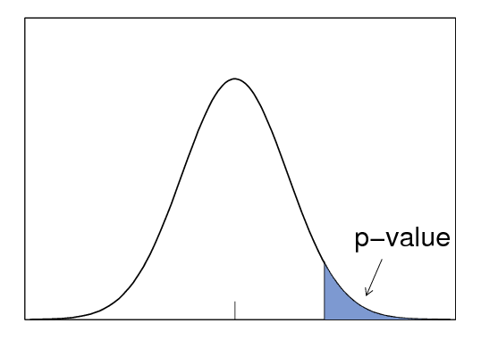
P-value
Distribution of data simulated assuming null is true
Observed value of the test statistic
The chance of seeing a test statistic equal to or further in the direction of our alternative hypothesis than our observed statistic, assuming the null were true.
In other words, the proportion of simulated data (assuming the null is true) that has a test statistic equal or more extreme than the observed statistic.

Slide 18
P-value Code
further in the direction of the alternative
these values were created under the null observed value of test statistic
# times a test statistic is the observed value or further total # of test statistics simulated under the null
equal to
p_value = np.count_nonzero(all_test_stats >= 20) / 1000

Slide 19
P-Value Interpretation
P-value cutoff (or significance level) chosen before testing
P-value cutoff - how strong you require the evidence against the null hypothesis to be before rejecting it (often is 0.01 or 0.05).
P-Value is small → seeing observed value is highly unlikely assuming the null is true
→ but we saw the observed value in real world...
→ data is not consistent with the null
P-Value < cutoff, then reject the null
P-Value > cutoff, then fail to reject the null

Slide 20
Practice: Adeel Loses
Adeel loves playing at the casino. His favorite game is craps, a dice rolling game. One day, he doesn’t do very well (only getting 7 sixes in 100 rolls of the die), and he suspects the house has been using loaded dice! In other words, he thinks the casino’s dice are less likely to roll a 6 than normal dice.
What should his null hypothesis be?
What should his alternative hypothesis be?
What test statistic should he use?
What's the observed value of the test statistic?
What size of values of the test statistic do you
expect if the alternative is true?

Slide 21
Practice: Adeel Loses
What should his null hypothesis be? Each roll is a 6 with probability ⅙, and any deviation in his sample is due to chance.
What should his alternative hypothesis be? Each roll is a 6 with probability less than ⅙.
What test statistic should he use? Proportion of 6s in 100 rolls.
What is the observed value? 7/100
What size of values of the test statistic do you expect if the alternative is true? small!

Slide 22
Practice: Adeel Loses
Simulate Adeel's test statistic 10000 times and compute the p-value
fair_die = make_array(⅙,⅙,⅙,⅙,⅙,⅙)
proportions = make_array()
for i in np.arange(10000): proportion = sample_proportions(100, fair_die).item(5) proportions = np.append(proportions, proportion)
p_value = np.count_nonzero(proportions <= 7/100) / 10000

Slide 23
Practice: Delivery Wait Times
SuperEats promises food delivery times of 25 minutes. The fine print says that SuperEats only promises that each customer's delivery time is a random sample from a normal distribution with a mean of 25 minutes and a standard deviation of 8 minutes.
Annie makes an order on SuperEats but finds the delivery time
to be a lot longer than advertised. She decides to conduct a
hypothesis test to determine if the mean delivery time is more
or less than 25 minutes. To conduct the test, she orders 30 items
from SuperEats and measures how long each delivery takes.
What is the null hypothesis?
The alternative hypothesis?
What are some examples of valid and invalid test statistics?

Slide 24
Practice: Delivery Wait Times
What is the null hypothesis? The alternative hypothesis? A valid and invalid test statistic?
Null: The average delivery time is 25 minutes.
Alt: The average delivery time is not 25 minutes.
Test Stats
Valid: Absolute difference between the mean delivery time of the 30 deliveries and the advertised delivery time (25 minutes).
Invalid: Mean of the 30 delivery times

Slide 25
Practice: Delivery Wait Times
Annie placed the 30 orders and calculated the total wait time to be 870 min.
Given a histogram of simulated test statistics, how would you find the p-value?
Solution:
The observed test stat = abs(870/30 - 25) = abs(29-25) = 4
Find the total area of the bins that are equal to or larger than 4.

Slide 26
Practice: Delivery Wait Times
If the null hypothesis is true, what is the chance that Annie still rejects if she chooses a significance level of 0.05?
Solution:
There's a chance under the null of getting test statistics greater than the observed value, which may lead us to believe the alternative. If we use a p% cutoff and the null is true, there's a p% chance we will incorrectly reject the null.

Slide 27
Practice: Delivery Wait Times
If we use a p% cutoff and the null is true, there's a p% chance the test will still reject the null. Why do medical scenarios usually use a smaller p-value cutoff?
Solution:
If the null is true, e.g. if a drug has no effect, the test will conclude that the drug does have an effect p% of the time. This could lead to the prescription of a drug with potentially dangerous side effects that doesn’t actually treat the condition in question. By reducing the p-value cutoff, drug developers reduce the likelihood that an ineffectual drug makes its way to market.

Slide 28
A/B Testing and Decisions

Slide 29
A/B Testing
A special hypothesis test to determine whether two samples come from the same underlying distribution.
If the 2 come from the same underlying distribution, then the labels don't matter. Shuffle them to simulate the null hypothesis
Shuffle a column by sampling a table without replacement
Remember that shuffling the values column instead would achieve the same outcome

Slide 30
A/B Testing & Hypothesis Testing
Similarities
Both include a null hypothesis and an alternative hypothesis.
For a set number of repetitions, both processes involve:
Drawing a sample and calculating a test statistic.
Features specific to A/B testing:
Test statistic is often (but not always) the difference or absolute difference between group means
Difference if alternative hypothesis has a direction
Absolute difference if alternative hypothesis test does not have a direction
Null hypothesis is simulated by shuffling the labels column of the table

Slide 31
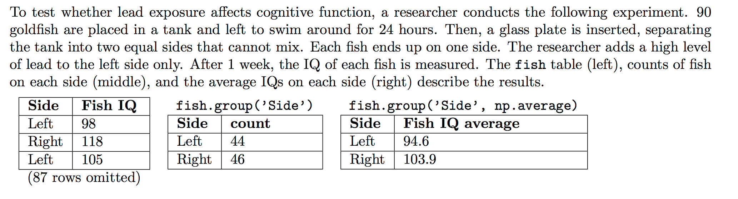
Fish
Write out the null hypothesis in this experiment about lead exposure affecting fish IQ

Slide 32
Fish
Write out the null hypothesis in this experiment about lead exposure affecting fish IQ
Among the fish in the experiment, the distribution of IQ scores of the fish exposed to lead is the same as the distribution of IQ scores of fish not exposed to lead. Any variation is due to chance.

Slide 33
Fish
You choose as your test statistic the absolute difference in average fish IQ scores for the two groups. Complete the absolute_differences_of_averages function below. The argument t is a two-column table such as fish in which column 0 indicates to which group each example belongs, and column 1 contains quantitative data. Note, that for this exercise there is no dataset for you to work with in a Jupyter Notebook.
def absolute_differences_of_averages(t):
averages = ______________________________________________
return abs(np.diff(averages).item(0))

Slide 34
Fish
You choose as your test statistic the absolute difference in average fish IQ scores for the two groups. Complete the absolute_differences_of_averages function below. The argument t is a two-column table such as fish in which column 0 indicates to which group each example belongs, and column 1 contains quantitative data. Note, that for this exercise there is no dataset for you to work with in a Jupyter Notebook.
def absolute_differences_of_averages(t):
averages = t.group(0, np.average).column(1)
return abs(np.diff(averages).item(0))

Slide 35
Fish
Assuming that fish are randomly distributed among the two sides, a p-value of 0.003 indicates that lead exposure causes a change in IQ. True or False? Briefly Justify your answer.

Slide 36
Fish
Assuming that fish are randomly distributed among the two sides, a p-value of 0.003 indicates that lead exposure causes a change in IQ. True or False? Briefly Justify your answer.
True. This is a randomized controlled experiment, so causation can be concluded.

Slide 37
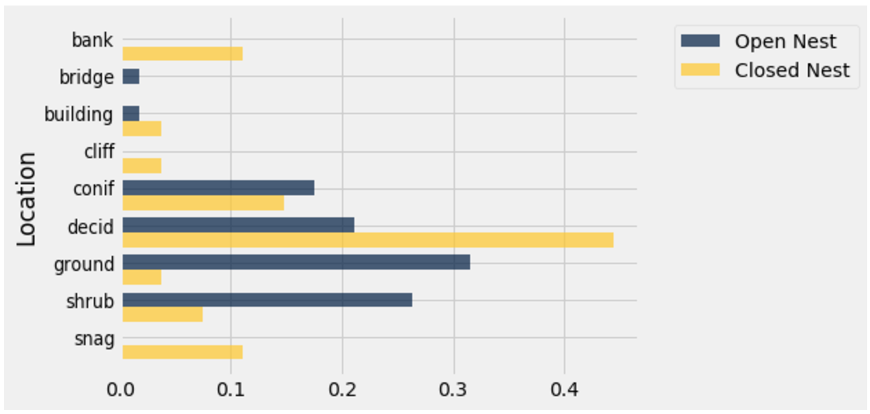
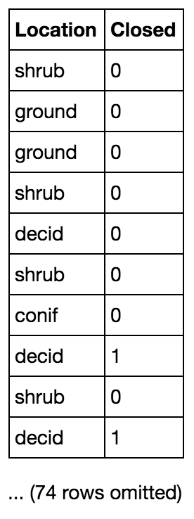
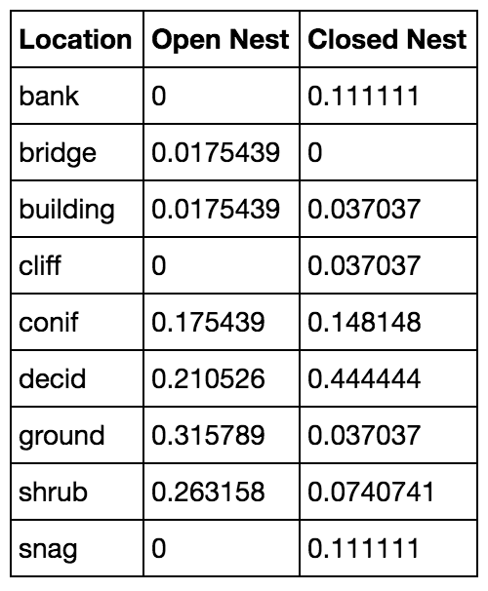
birds
dists
Annie is a bird enthusiast and wants to determine whether the location of a bird’s nest is related to whether the nest is open or closed. She has gone around and collected data about birds’ nest locations and whether or not their nests are closed (1 = closed, 0 = open). She compiled all of the information into a table called birds. The first 10 rows of birds are shown below along with a bar graph and the table dists that contains the proportion of each type of nest in every location in the sample. Annie would like to know whether the distribution of locations of closed nests is similar to that of the distribution of locations of open nests. Note, that for this exercise there is no dataset for you to work with in a Jupyter Notebook.

Slide 38
Bird Nests
Write a null hypothesis for this test.

Slide 39
Bird Nests
Write a null hypothesis for this test.
In the population, the distributions of locations of closed nests and open nests are the same. Any variation in the sample is due to chance.

Slide 40
Bird Nests
Given that both variables are categorical, what is a good test statistic for this analysis?
Write a function to compute this test statistic. Assume that dist1 and dist2 are arrays.
def test_stat(dist1, dist2):
return ___________________________________

Slide 41
Bird Nests
Given that both variables are categorical, what is a good test statistic for this analysis?
Write a function to compute this test statistic. Assume that dist1 and dist2 are arrays.
def test_stat(dist1, dist2):
return ___________________________________
Total variation distance
0.5*(np.sum(np.abs(dist1 - dist2)))

Slide 42
Bird Nests
Complete the following code to use A/B testing and compute the P-value. Assume that you are given a function proportions that converts an array of counts to an array of proportions. For reference, the first 2 rows of birds and dists are shown above.
observed_stat = test_stat(________, _________)
stats = make_array()
reps = 10000
for i in np.arange(________):
shuffled_loc = birds.select("Location").sample(with_replacement=___).column(0)
shuffled = birds.drop(_______).with_column(“Shuffled Location”, ____________)
shuffled_counts = shuffled.pivot("Closed", _______________)
new_stat = _________(proportions(______________), proportions(____________))
_________ = np.append(stats, ____________)
emp_p = ______________________________________
birds
dists

Slide 43
Bird Nests
Complete the following code to use A/B testing and compute the P-value. Assume that you are given a function proportions that converts an array of counts to an array of proportions. For reference, the first 2 rows of birds and dists are shown above.
observed_stat = test_stat(dists.column(1), dists.column(2))
stats = make_array()
reps = 10000
for i in np.arange(reps):
shuffled_loc =birds.select("Location").sample(with_replacement=False).column(0)
shuffled =birds.drop("Location").with_column(“Shuffled Location”, shuffled_loc)
shuffled_counts = shuffled.pivot("Closed", “Shuffled Location”)
new_stat = test_stat(proportions(shuffled_counts.column(1), proportions(shuffled_counts.column(2)))
stats = np.append(stats, new_stat)
emp_p = np.count_nonzero(stats >= observed_stat)/reps
birds
dists

Slide 44
The Bootstrap and CIs

Slide 45
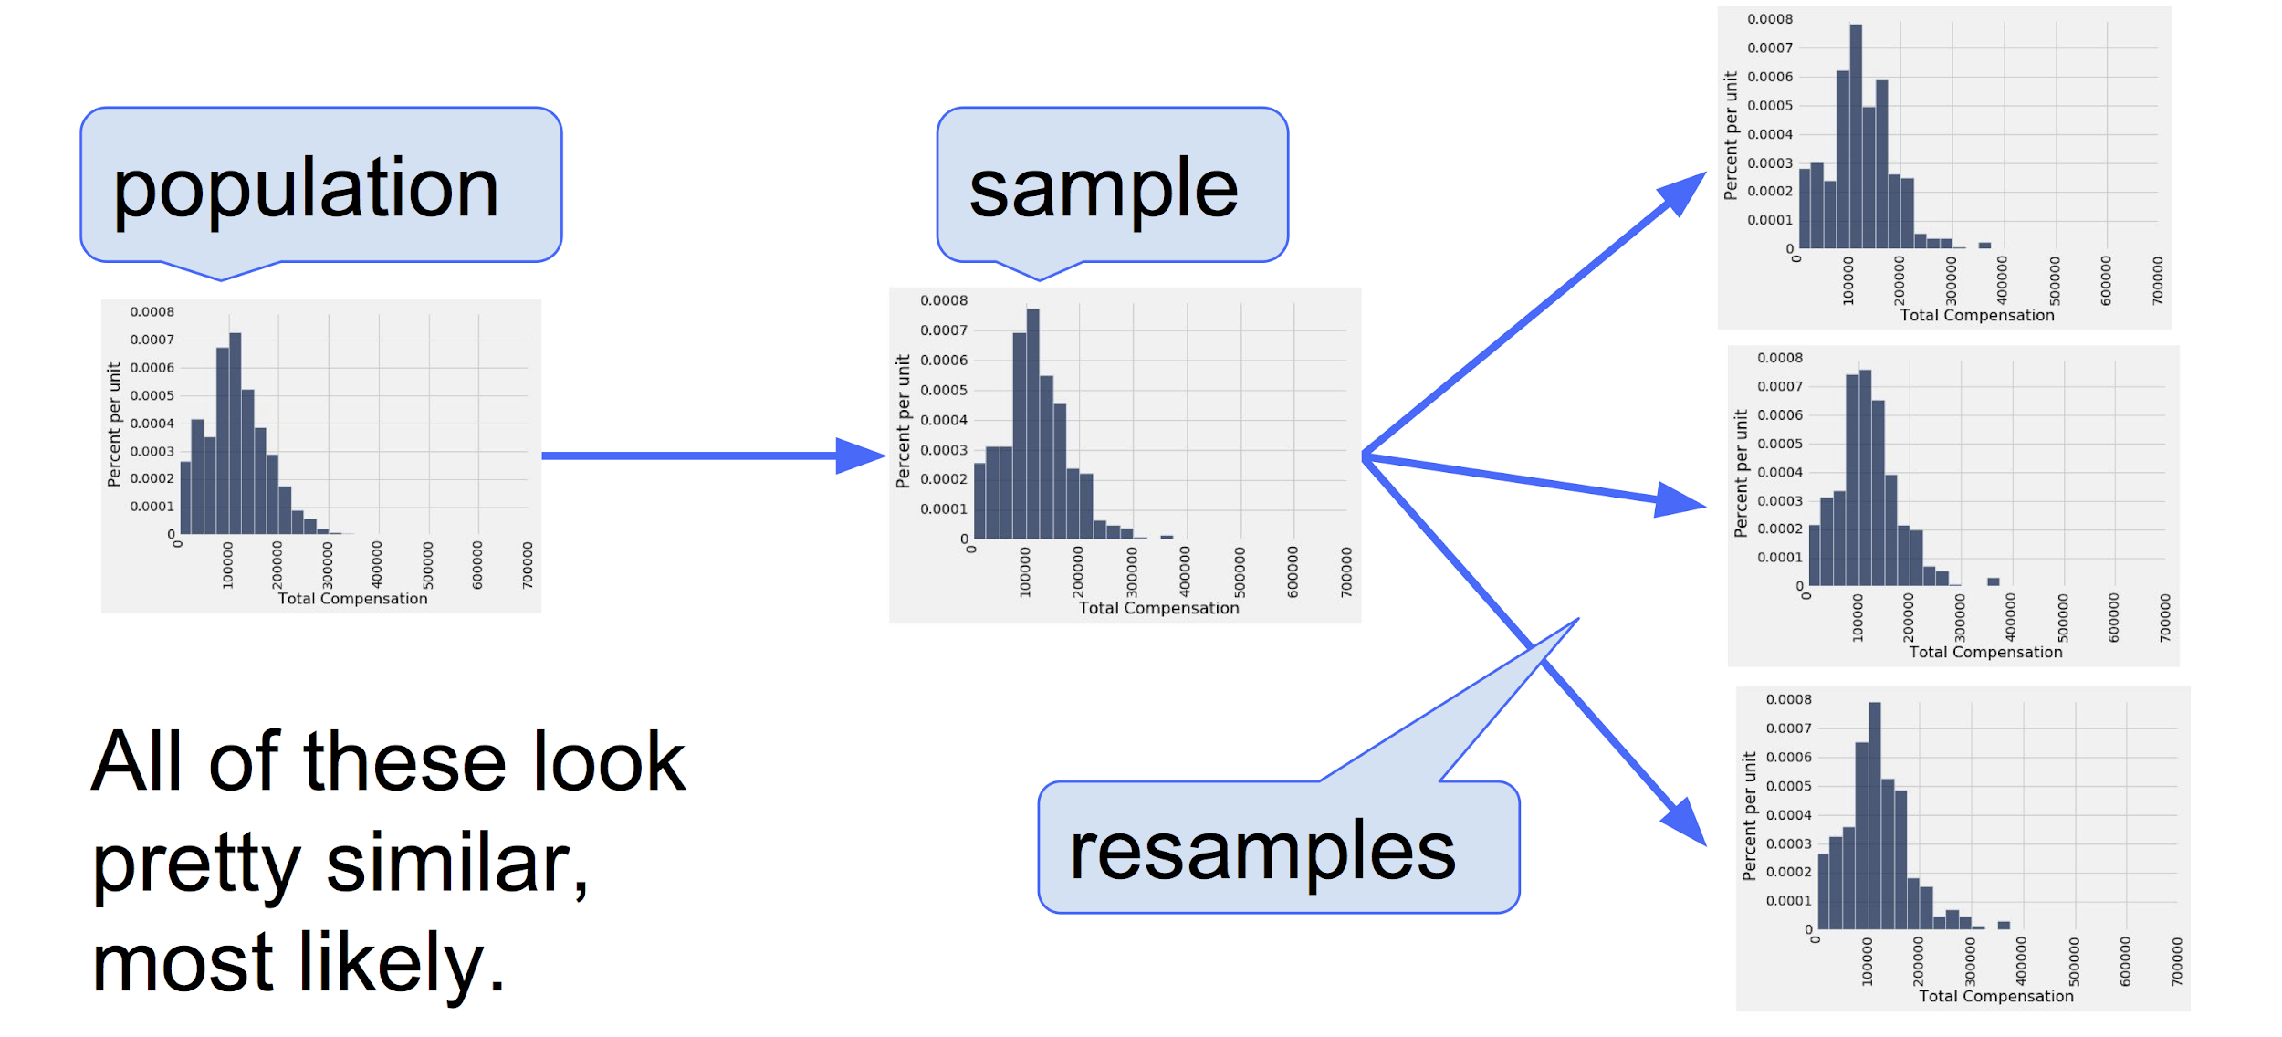
Bootstrap
We take a sample to get an estimate for a population parameter (e.g. the mean)
We’d like to get an idea of how much our estimate would change if we got a different sample from the population. (But we can’t get another sample a lot of the time!)
Bootstrap: We treat our collected sample as the population, and resample with replacement the same size as the original sample.

Slide 46
Bootstrap
Steps:
Treat our sample as the data we have access to
Draw with replacement with the same size as the original sample
This allows each sample to have a different calculated test statistic
Each sample size is the same to keep the variance the same
Take the middle 95% of the range of bootstrapped values to create a CI
Uses:
When you only have access limited amount of data
Helps create CIs to estimate a parameter, and can be used to run hypothesis tests

Slide 47
Similarity between HT and Bootstrap CI
def hypothesis_test(observed, statistic):
stats = make_array()
for i in np.arange(10000):
sample = <sample from null dist>
sample_stat = statistic(sample)
stats = np.append(stats, sample_stat)
return np.mean(stats >= statistic(observed))
*Note: This function assumes a right-sided alternative hypothesis. Computation of p-value may be different for other alternate hypotheses.
def bootstrap(observed, statistic):
stats = make_array()
for i in np.arange(10000):
sample = <resample from observed>
sample_stat = statistic(sample)
stats = np.append(stats, sample_stat)
lower = percentile(2.5, stats)
upper = percentile(97.5, stats)
return make_array(lower, upper)
Important Note: These functions combine much of what we’ve done in functions that only return p-values or confidence intervals

Slide 48
Bootstrap Code
Define a function called bootstrap that will bootstrap from a sample 10,000 times using the mean as the test statistic. Assume that column 0 is the column with the data we care about.
def bootstrap(tbl):
statistics = make_array()
for __________________:
bootstrap_tbl = _____________________
statistic = ________________________
statistics = ________________________
return statistics

Slide 49
Bootstrap Code (Solution)
def bootstrap(tbl):
statistics = make_array()
for i in np.arange(10000):
bootstrap_tbl = tbl.sample()
statistic = np.mean(bootstrap_tbl.column(0))
statistics = np.append(statistics, statistic)
return statistics
*Note: tbl.sample() by default draws tbl.num_rows samples with replacement. tbl.sample(tbl.num_rows, with_replacement=True) would work as well.

Slide 50
Confidence Intervals

Slide 51
95% Confidence Intervals
Interval of estimates of a parameter
Based on random sampling
95% is called the confidence level
Could be any percent between 0 and 100
Higher level means wider intervals
The confidence is in the process that gives the interval:
It generates a “good” interval about 95% of the time i.e. one that contains the true population parameter

Slide 52
Is This What a CI Means?
An approximate 95% confidence interval for the average age of the mothers in the population is (26.9, 27.6) years.
True or False:
There is a 0.95 probability that the average age of mothers in the population is in the range 26.9 to 27.6 years.
Answer: False. The average age of the mothers in the population is unknown but it’s a constant. It’s not random. No chances involved.

Slide 53
Using CI for Hypothesis Test
Null hypothesis: Population average = x
Alternative hypothesis: Population average ≠ x
Cutoff for P-value: p%
Method:
Construct a (100-p)% confidence interval for the population average
If x is not in the interval, reject the null
If x is in the interval, can’t reject the null

Slide 54
CI Question
Hari goes to his favorite restaurant and feels that it’s not quite as good as he remembers. He goes on Yelp to find people who have reviewed the restaurant before the last time he ate there. He tracks down 100 of these people and asks them for their current rating of the restaurant so he can compare and see if the rating has dropped. To determine whether it has, he takes the difference between the old rating and the new rating (old rating - new rating).
Let rating_differences be an array of the differences in the ratings of all the people you surveyed. How can a confidence interval help Hari determine whether or not the restaurant’s quality has degraded?
Suppose Hari’s 95% confidence interval for the true mean rating drop is [0.135, 1.241]. Do you fail to reject or reject the null hypothesis (rating have dropped) with a p-value cutoff of 5%? How about 10%? 1%?

Slide 55
CI Question Answer
Let rating_differences be an array of the differences in the ratings of all the people you surveyed. How can a confidence interval help Hari determine whether or not the restaurant’s quality has degraded?
You can compute a (100 - 2p)% confidence interval for the true average of the drops in rating. If the interval is entirely positive (ie does not contain 0), then you can reject the null hypothesis with a significance level (p-value cutoff) of p%.

Slide 56
CI Question Answer
Suppose Hari’s 95% confidence interval for the true mean rating drop is [0.135, 1.241]. Do you fail to reject or reject the null hypothesis with a p-value cutoff of 5%? 10%? 1%?
5%: reject; 0 below the 90% CI, since this is narrower than the 95% CI
10%: reject; 0 below the 80% CI, since this is narrower than the 95% CI
1%: don’t know; 98% CI is wider than 95% CI. It could contain 0

Slide 57
Central Limit Theorem

Slide 58
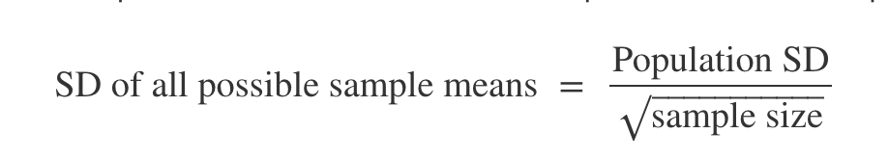
Central Limit Theorem
Law of Averages: As sample size increases, sample mean gets closer to population mean
Central Limit Theorem: Distribution of sample means/sums is approximately normal regardless of shape of population distribution
Mean of dist = population mean

Slide 59
Why is CLT useful for CI?
If we are investigating confidence intervals relating to means/sums, we don’t need simulation as we can use the properties of normal curve to calculate the intervals.

Slide 60
Confidence Interval Question
Avery has a single sample of 30 internet speeds from a population of speeds from a company. He finds that the mean of his sample is 350 mbps. The internet company claims that the distribution of speeds is normal with mean 400 mbps and SD 20mbps. Avery wants to construct a confidence interval to check their claim, but doesn’t have access to Python to run simulations
Using a sample size of 30, what is the distribution of sample means drawn from the null distribution? Would this distribution be the same if the advertised null distribution wasn’t normal?
How can Avery use this distribution to perform a test of his hypothesis with p-value cutoff of 2.5%?

Slide 61
Confidence Interval Question
Avery has a single sample of 30 internet speeds from a population of speeds from a company. He finds that the mean of his sample is 350 mbps. The internet company claims that the distribution of speeds is normal with mean 400 mbps and SD 20mbps. Avery wants to construct a confidence interval to check their claim, but doesn’t have access to Python to run simulations
What is the distribution of sample means drawn from the null distribution? Would this distribution be the same if the advertised null distribution wasn’t normal?
The sample mean has a normal distribution with mean 400 and standard deviation of 20 / sqrt(30). If the null distribution was not normal, the sample mean may still be normally distributed, because of the CLT, depending on the skew of the population.

Slide 62
Confidence Interval Question
Avery has a single sample of 30 internet speeds from a population of speeds from a company. He finds that the mean of his sample is 350 mbps. The internet company claims that the distribution of speeds is normal with mean 400 mbps and SD 20mbps. Avery wants to construct a confidence interval to check their claim, but doesn’t have access to Python to run simulations
How can Avery use this distribution to perform a test of his hypothesis with p-value cutoff of 2.5%?
He can use the 95% confidence interval for the sample mean, given by population mean ± 2*(sd of sample means). If 350 is within (or above) this range, then he cannot reject the null. If it is below the range, then he can reject the null.

Slide 63
Confidence Interval Question
A survey organization would like to find out what proportion of people like to cut the crusts off their sandwiches. Because of the uncertainty inherent in random sampling, they would like to report their result as a 95% confidence interval.
How many people should they survey to guarantee that the 95% confidence interval is no wider than 0.1 (i.e. ± 0.05)?

Slide 64
Confidence Interval Question
How many people should they survey to guarantee that the 95% confidence interval is no wider than 0.1?
The sample proportion is normally distributed with standard deviation given by:
SD_{sample_mean} = SD_{population}/sqrt(n), where n is the sample size.
A 95% confidence interval for a normally distributed random variable has width 4*SD, so the answer to this question is given by solving the inequality:
0.1 >= 4*SD_{sample_mean} = 4 * SD_{population} / sqrt(n)
Since we don’t know SD_{population}, we can take an upper bound. The upper bound is given by 0.5.
0.1 >= 4 * SD_{sample_means}
0.1 >= 4 SD_{population} / sqrt(n)
0.1 >= 4 (.5) / sqrt(n)
Solve for n: n >= (2/0.1)^2 = 400
n >= 400

